Slide 1
PROJECT EMPLOYEE ATTRITION

Slide 2
Introduction
A comprehensive analysis of employee attrition was conducted to address a persistent 15% annual turnover rate at a company established a few years ago. This high attrition rate significantly impacts productivity, team morale, and operational costs.
This project aims to provide insights into the factors influencing employee attrition and predict which employees are likely to leave the company. Let's refine the project to make it more closely aligned with real-time scenarios and address live problem statements within an organization.

Slide 3
Given Tasks
Identify patterns and trends in employee attrition.
Analyze demographic and job-related factors that contribute to higher attrition rates.
Develop predictive models to identify employees at risk of leaving.
Create visualizations and dashboards to support data-driven decision-making.
Propose targeted interventions to improve employee retention.

Slide 4
Details of Data
Data has been provided historical data on employee demographics, job satisfaction, work environment, performance metrics, and turnover status. This dataset spans the last five years and includes information on employees who have left the company and those who are still currently employed.

Slide 5
Tools Used
Excel
Tableau

Slide 6
Main KPI’s
Key Performance Indicators (KPI’s) are critical metrics that help in evaluating the effectiveness and overall health of the organization.
It provides insights into various aspects such as attrition and retention rate, salary, performance, and employee satisfaction.
High attrition rate in certain departments while average ratings on job satisfaction and work-life balance can guide improvements in workplace policies and practices.
Attrition Rate: 16.12%
Retention Rate: 83.88%
Average Salary: 65,029.31
Average Salary Hike: 15.21%
Average Performance rating: 3.15

Slide 7
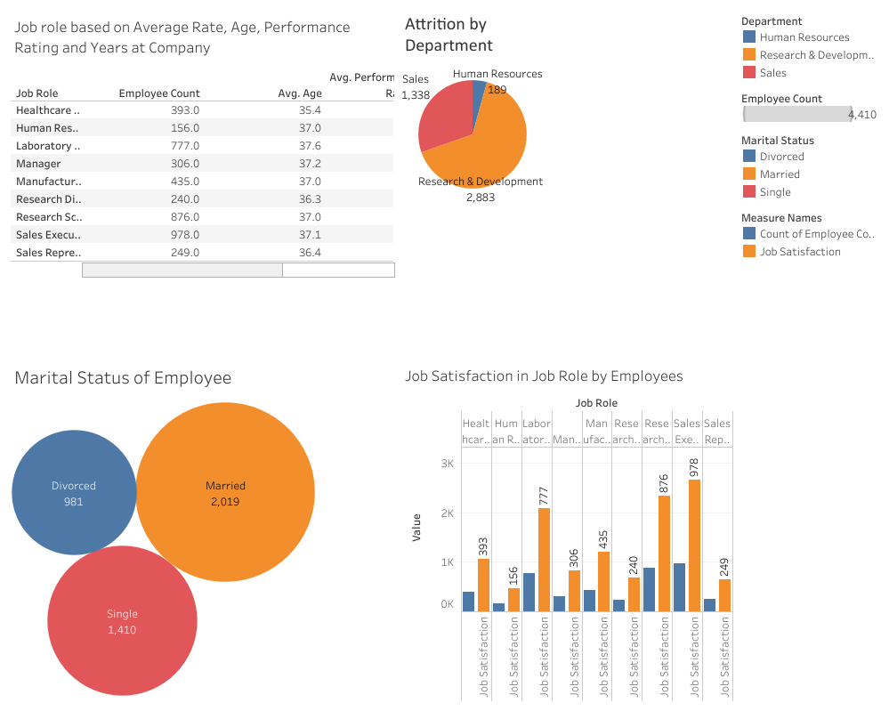
Dashboards 1

Slide 8
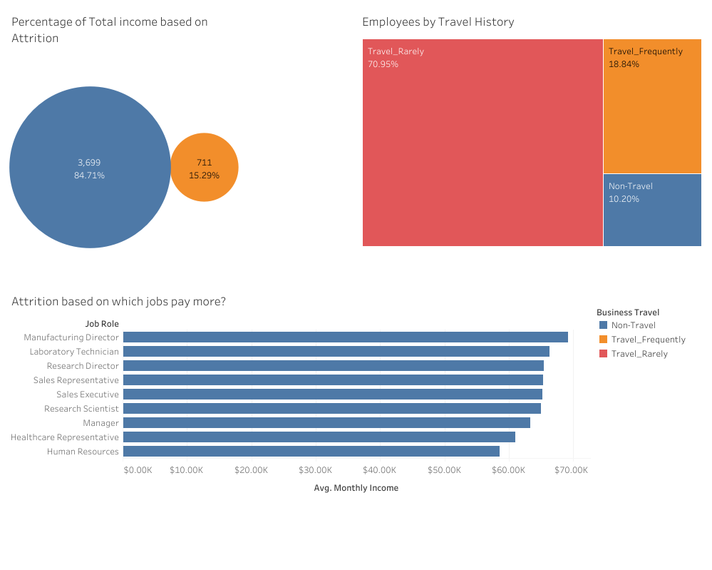
Dashboard 2

Slide 9
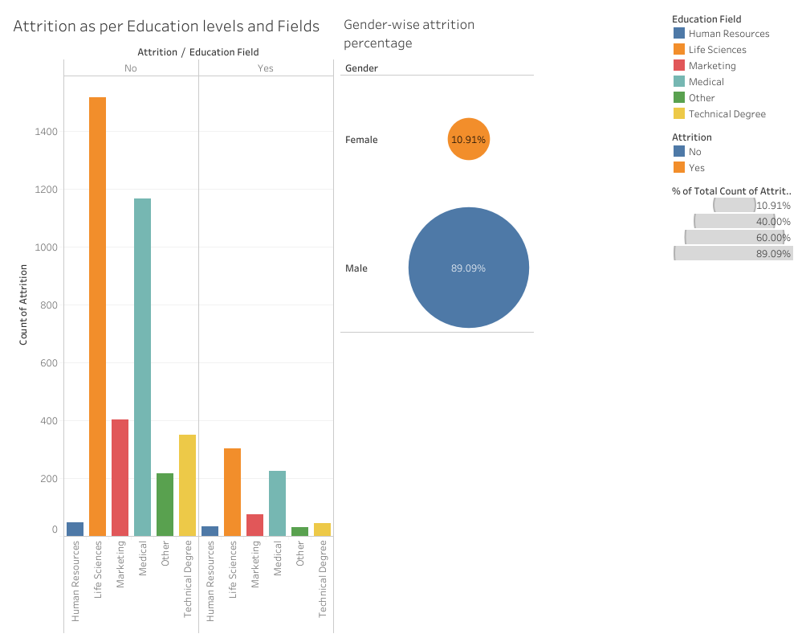
Dashboard 3

Slide 10
Thank you

